Slide 1
Predicting Results of Indian Premier League T-20 Matches using Machine Learning
Authors
Shilpi Agrawal
Suraj Pal Singh
Jayash Kumar Sharma

Slide 2
Introduction
Cricket is most widespread and much-loved game of everyone in India
IPL is one of the finest twenty-20 cricket competition in present cricketing world
Results of every match in the IPL depends on the various conditions like venue, player performance, toss, performance in power play etc. Results of a match can only be predicted to some extent if previous player performance, venue and other match related data is available. In this paper authors predict the result of IPL matches using two machine learning algorithms namely Support Vector Machine (SVM), and Na¨ıve Bayes on the basis of previous data available

Slide 3
Block diagram of Approach

Slide 4
Data Preprocessing
Real-world data generally contains noises, missing values, and maybe in an unusable format which cannot be directly used for machine learning models. Data preprocessing is required tasks for cleaning the data and making it suitable for a machine learning model which also increases the accuracy and efficiency of a machine learning model.
Data where results have not been declared or marked are removed during this stage

Slide 5
Converting Categorical Data into Numerical
Data provided in dataset is categorical in nature due to
which classification is quiet complex. It may also affect classification
process resulting in wrong prediction. In this step all
categorical data in dataset have been converted into numeric format and normalized .
Match ID, Season, City
Team1 ,Team2 ,Toss Winner
Toss Decision, Result, Winner
Win By Runs ,Win By Wickets ,Player of the Match
Venue

Slide 6
Feature Extraction
Feature extraction is a process of dimensionality reduction by which an initial set of raw data is reduced to more manageable groups for processing. A characteristic of these large data sets is a large number of variables that require a lot of computing resources to process.
Feature extraction is the name for methods that select and /or combine variables into features, effectively reducing the amount of data that must be processed, while still accurately and completely describing the original data set.
Following key features for both teams (batting and bowling)
and for both innings have been identified which can help in result prediction:
Average Run Rate
Average Strike Rate
Power Play Strike Rate

Slide 7
Support Vector Machine Algorithm
Support Vector Machine or SVM is one of the most popular Supervised Learning algorithms.
The goal of the SVM algorithm is to create the best line or decision boundary that can segregate n-dimensional space into classes so that we can easily put the new data point in the correct category in the future. This best decision boundary is called a hyperplane.
SVM chooses the extreme points/vectors that help in creating the hyperplane. These extreme cases are called as support vectors, and hence algorithm is termed as Support Vector Machine. Consider the below diagram in which there are two different categories that are classified using a decision boundary or hyperplane:

Slide 8

SVM

Slide 9
Naïve Bayes Algorithm
It is a classification technique based on Bayes’ Theorem with an assumption of independence among predictors. In simple terms, a Naive Bayes classifier assumes that the presence of a particular feature in a class is unrelated to the presence of any other feature.
For example, a fruit may be considered to be an apple if it is red, round, and about 3 inches in diameter. Even if these features depend on each other or upon the existence of the other features, all of these properties independently contribute to the probability that this fruit is an apple and that is why it is known as ‘Naive’.

Slide 10
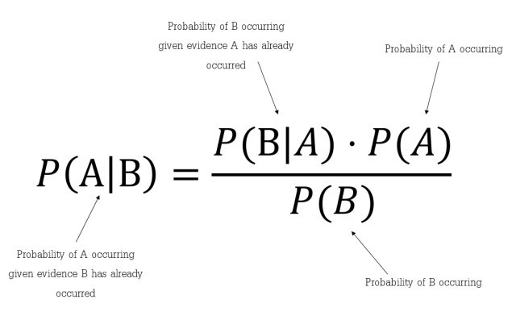

Slide 11
Results
The model dataset originally has 500 records of IPL T-20 matches which
has been divided into two sets. First set is referred as Training
Dataset (comprising of 400 records) while second set is
referred as Test Dataset (comprising of 99 record). One record
was ignored during pre-processing due to non-availability of
results. Training dataset is trained with SVM, Na¨ıve Bayes
obtained knowledge is used to predict results of Test dataset. Further achieved results are evaluated on the basis of accuracy, precision, recall and F-measure.

Slide 12
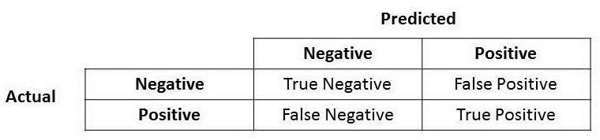
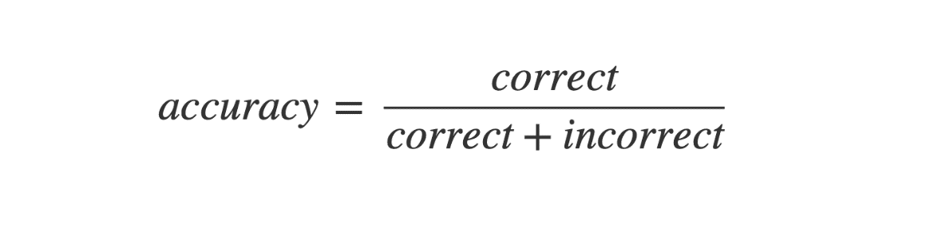
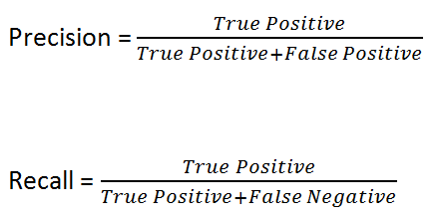

results

Slide 13
Classifiers | Accuracy
SVM | 95.96%
Naive Bayes | 98.98%

Slide 14
Results
Case | Precision | Recall | F-measure
Draw | 0 | 0 | 0
Team 2 Win | 96.22 | 98.07 | 97.14
Team 1 Win | 97.95 | 100.00 | 98.96
Case | Precision | Recall | F-measure
Draw | 100 | 66.66 | 80
Team 2 Win | 100 | 100 | 100
Team 1 Win | 97.95 | 100 | 98

Slide 15
Summary
In this work, historical data has been collected from real IPL
cricket matches and useful features have been extracted after
pre-processing of data. Further, suitable data is converted to
a numeric form and scale it on three parameters win, loss,
and tie. This data is trained and classified with two classifiers
SVM and Na¨ıve Bayes and results are obtained.

Slide 16
Conclusion
This data is trained and classified with two classifiers-
SVM and Na¨ıve Bayes . Outstanding results have been achieved using
Na¨ıve Bayes classifier with an overall accuracy of 98.98%.
SVM gives an accuracy of 95.96% so we conclude Naïve Bayes as the best algorithm to be used for this dataset.

Slide 17
Future Work
As our approach well predicts the IPL in current scenario that
is based on the history records, it can be further extended in
changing environment when many new talents join the team,
their history records are made available. Further it can be
tested by analyzing IPL 2021 match result. Accordingly, new
features vectors can be identified and prediction can be made
more accurate.

Slide 18
Bibliography
REFERENCES
[1] D. Parker, P. Burns, Natarajan, H. Player, ”valuations in the Indian
Premier League”, Frontier Economics, October, 2008, 1-17.
[2] Joachims T, Nedellec C, and Rouveirol C.(Eds.),”Text categorization
with Support Vector Machines: Learning with many relevant features
Machine Learning”, ECML-98, Springer Berlin Heidelberg, 1998, 137-
142.
[3] Kansal P, Kumar P, Arya H and Methaila A, ”Player valuation in Indian
premier league auction using data mining technique”, International
Conference on Contemporary Computing and Informatics (IC3I), 2014,
197-203.
[4] K. A. A. D. Raj and P. Padma, ”Application of Association Rule
Mining: A case study on team India”, 2013 International Conference

Slide 19
on Computer Communication and Informatics, 2013
[5] Saikia, Hemanta and Bhattacharjee, Dibyojyoti, ”On classification of
all-rounders of the indian premier league (IPL): A Bayesian approach”,
Vikalpa, 2011, 36, 51-66
[6] S. Singh, ”Measuring the Performance of Teams in the Indian Premier
Leaguee”,American Journal of Operations Research, 2011, vol 1, No 3,
pp 180-184
[7] Stylianos Kampakis, William Thomas,”Using Machine Learning to
Predict the Outcome of English County twenty over Cricket Matches”,
Cornell University, 2015
[8] Tim B. SWARTZ, Paramjit S Gill and S. Muthukumarana,”Modelling
and simulation for one-day cricket”, Canadian Journal of Statistics, 2009,
Vol 37, No 2, pp-143-160
[9] Veppur Sankaranarayanan, Vignesh and Sattar, Junaed and
Lakshmanan,”Auto-play: A Data Mining Approach to ODI Cricket
Simulation and Prediction”,SIAM Conference on Data Mining, 2014
􀀁􀀘􀀒

Slide 20
Strategy For Implementation
Using Python and sci-kit learn library and IPL Dataset from Kaggle,
Will make use of the approach of the authors of the paper and perform
EDA,Feature Engineering,Preprocessing and try out different models to
predict THE FIRST INNINGS SCORE of an IPL match
We will try to solve the regression problem and create a web app to help with the predictions

